Slide 1

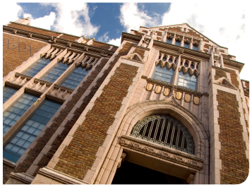


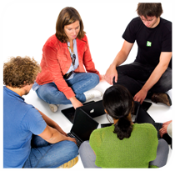

.
Qt in Education
Custom
Widgets
and
Painting
Notes:
This lesson introduces QWidget, QStyle, Qt events, QPainter and briefly touches the QtSvg module and QTextDocument classes.
Recommended reading:
http://doc.trolltech.com/4.6/widgets-and-layouts.html
http://doc.trolltech.com/4.6/style-reference.html
http://doc.trolltech.com/4.6/paintsystem.html

Slide 2


© 2011 Nokia Corporation and its Subsidiary(-ies).
The enclosed Qt Materials are provided under the Creative Commons
Attribution-Share Alike 2.5 License Agreement.
The full license text is available here:
http://creativecommons.org/licenses/by-sa/2.5/legalcode.
Nokia, Qt and the Nokia and Qt logos are the registered trademarks
of Nokia Corporation in Finland and other countries worldwide.

Slide 3


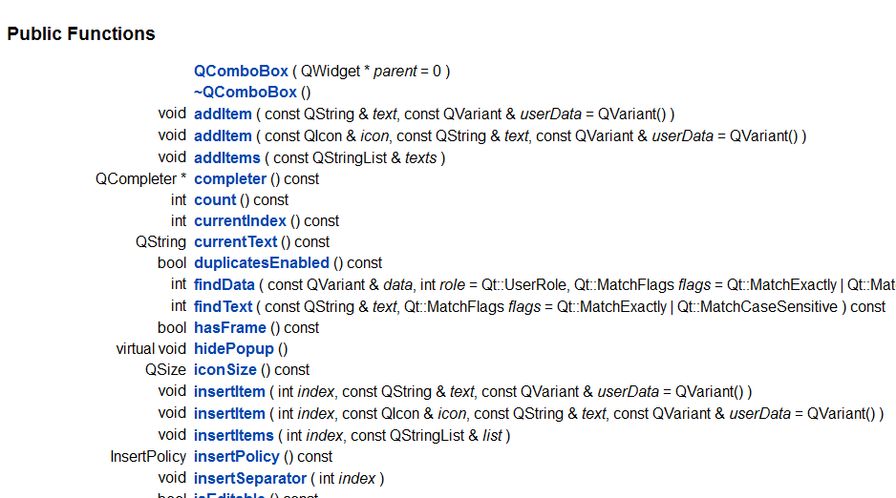
What is a Widget?
Look
Feel
API
Notes:
A widget encapsulates an element on screen.
To the users, that means look and feel.
The the developer using the widget, that means providing an API consisting of methods, properties, signals and slots.
Continues

Slide 4

Custom Widgets
Custom widgets can make or break a user experience
  Custom widgets can enhance the look and feel
  Custom widgets can help brand a user interface
  Custom widgets are almost always a part of a non-trivial application
  Beware – users know how the standard widgets work
Notes:
For many applications, the standard widgets are not enough. Then you have to develop custom widgets.
When developing custom widgets it is important to keep the user in mind.
Custom widgets can enhance the look and feel
They can help adding a brand feel to a user interface
It is important to keep in mind that they can also confuse the user and introduce unfamiliar elements
Remember that the users know how the standard widgets work. Anything that works in a different manner can be confusing.
Continues

Slide 5


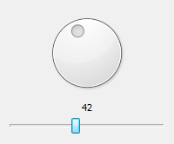
Composing Widgets
Composing widgets is an easy way to build re-usable widgets from existing components
QDial
=
QLabel
ComposedGauge
QSlider
QVBoxLayout
Notes:
The easiest way to create custom widgets is to compose them from existing widgets.
This lets you create a group of widgets that are easy to reuse and that provide a convenient API.
For instance, here we merge a dial, a label and a slider into the ComposedGauge widget class.
Continues

Slide 6
Composing Widgets
ComposedGauge::ComposedGauge(QWidget *parent) :
QWidget(parent)
{
QVBoxLayout *layout = new QVBoxLayout(this);
QDial *dial = new QDial();
QLabel *label = new QLabel();
m_slider = new QSlider();
layout->addWidget(dial);
layout->addWidget(label);
layout->addWidget(m_slider);
m_slider->setOrientation(Qt::Horizontal);
label->setAlignment(Qt::AlignCenter);
...
Notes:
The constructor of the new class shows us how it is done.
The ComposedGauge class is derived from QWidget.
It contains the child widgets inside a vertical box layout.
The code also spends some time tuning the properties of the widgets involved.
Continues

Slide 7
Look and Feel
When composing widgets, the look and feel is inherited from the widgets used
Click the dial
to set a value
Click the slider to
set a value
Keyboard can also
be used to set a value
Notes:
One benefit of composed widgets is that the look and feel is preserved.
This means that the user can use the child widgets as expected.
Continues

Slide 8
Addressing the Feel
ComposedGauge::ComposedGauge(QWidget *parent) :
QWidget(parent)
{
...
connect(dial, SIGNAL(valueChanged(int)),
m_slider, SLOT(setValue(int)));
connect(m_slider, SIGNAL(valueChanged(int)),
dial, SLOT(setValue(int)));
connect(m_slider, SIGNAL(valueChanged(int)),
label, SLOT(setNum(int)));
dial->setFocusPolicy(Qt::NoFocus);
dial->setValue(m_slider->value());
label->setNum(m_slider->value());
...
Notes:
The interconnections of the available functions to provide the expected behavior takes place in the constructor.
Signals and slots are connected to make the components interact.
Focus policies direct the keyboard focus to the slider (the label cannot be focused from the start).
The values are then initialized. Notice that the slider widget is given the lead.
Continues

Slide 9
API
Wrapping the composed widgets in a task specific API makes the widget easy to (re)use
class ComposedGauge : public QWidget
{
Q_OBJECT
Q_PROPERTY(int value READ value WRITE setValue)
public:
explicit ComposedGauge(QWidget *parent = 0);
int value() const;
public slots:
void setValue(int);
signals:
void valueChanged(int);
private:
QSlider *m_slider;
};
Notes:
Having interconnected all the child widgets and setup the look and feel, it is time to provide a convenient API.
The value property feels natural. It adds a getter method, a setter slot and a signal.
Continues

Slide 10
Implementing the API
The QSlider holds the actual value
ComposedGauge::ComposedGauge(QWidget *parent) :
QWidget(parent)
{
...
connect(m_slider, SIGNAL(valueChanged(int)),
this, SIGNAL(valueChanged(int)));
}
int ComposedGauge::value() const
{
return m_slider->value();
}
void ComposedGauge::setValue(int v)
{
m_slider->setValue(v);
}
Notes:
Implementing the API is a question of making more connections.
We can connect a signal from a child widget to the signal of the ComposedGauge. This simply passes the signal along.
In the getter and setter methods the slider is used as a the holder of the value.
Letting the child widgets manage the values saves the trouble of keeping a property value and keeping it in sync with all the components.
Continues

Slide 11
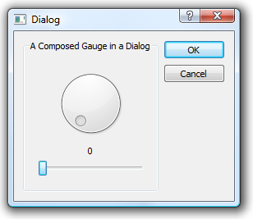
Using the Widget
...
ComposedGauge *gauge = new ComposedGauge();
layout->addWidget(gauge);
connect(gauge, SIGNAL(valueChanged(int)), ... );
...
Notes:
When using the ComposedGauge widget, it behaves as a set of interconnected familiar widgets to the user. The look and feel is as expected.
To the developer, it behaves just as a single value keeping widget with setValue, value, valueChanged, etc.
The child widgets has been built into a re-usable component.
When looking at the component as a whole it is important to recognize that the new API still is application independent. This means that the component can be re-used in more applications in the future.
It is not always possible (or even the right thing) to provide a non-application-dependent API, but if possible you should consider it.

Slide 12
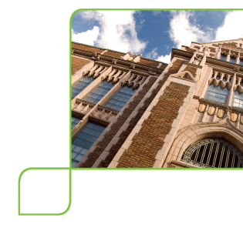
Custom Widgets
To create truly custom widgets you must
  Handle painting yourself
  Handle events
    Keyboard
    Mouse
    Resize
    etc
  Handle size hints and size policies
Notes:
When composing new looks from existing widgets isn't enough, you must implement a truly custom widget.
This means handling the painting yourself. This gives you full control of the look of the widget
You must also handle events from sources such as mouse, keyboard and timers. This gives you full control of the feel of the widget.
You must also interact with other widgets as a nice citizen. This involves hinting sizes, providing sane size policies, reacting to resizing, etc.
Continues

Slide 13

Custom Painting
Painting is handled through the paintEvent
Shown
The Qt
event loop
Unobstructed
paintEvent
update called
repaint called
Notes:
Custom painting of widgets is not always a straight forward process.
All painting to the screen must take place in the paintEvent function. You can of course paint to other surfaces (such as Qimage and Qpixmap objecs) outside paintEvent, but never to the screen.
A paint event is called from the Qt event loop. The Qt event loop optimizes for speed and flicker, i.e. if several small areas are requested to be repainted, only a single repaint may be scheduled, etc.
Sources of paint events can be external, i.e. a (part of a) window is shown, or internal, i.e. a call to update.
Using the repaint method you can trigger an update immediately, unless the widget is hidden or obstructed. You should only be using this method when it is strictly needed.
Continues

Slide 14
Custom Painting
To handle paint events, simply override the paintEvent function and instantiate a QPainter
class MyWidget : public QWidget
{
...
protected:
void paintEvent(QPaintEvent*);
void MyWidget::paintEvent(QPaintEvent *ev)
{
QPainter p(this);
...
Notes:
Handling the paintEvent requires re-implementing the protected paintEvent method.
In the method implementation, a QPainter object for painting on the widget, i.e. this.
Continues

Slide 15
QPainter
QPainter objects paint on QPaintDevice objects
  QWidget
  QImage – hardware independent, for modifying
  QPixmap – off-screen, for showing on screen
  QPrinter
  QPicture – records and replays painter commands
  QSvgGenerator – records painter commands and stores them as SVG files
Notes:
The QPainter class is used to paint on various surfaces. All paintable surfaces inherits the QPaintDevice class.
Examples of paintable surfaces are:
QWidget, i.e. on-screen widgets.
QImage, an off-screen image optimized for modification
QPixmap, an off-screen image optimized for showing on screen
QPrinter, representing a printer
QPicture, records and replays painter commands
QSvgGenerator, records painter commands to SVG (scalable vector graphics, a w3c standard) files.
Continues

Slide 16
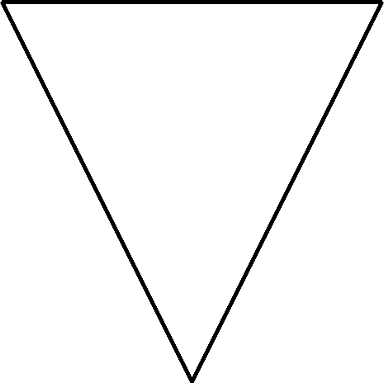

QPainter
A QPainter can be used to draw any shape
Outlines are stroked using a QPen
Interiors are filled using a QBrush
QPainter p( ... );
QPen pen(Qt::black, 5);
p.setPen(pen);
p.drawPolygon(polygon);
QPainter p( ... );
p.setPen(Qt::NoPen);
p.setBrush(Qt::red);
p.drawPolygon(polygon);
Notes:
Using a QPainter, you can draw any conceivable shape.
Shapes are painted using a pen and a brush. The pen is applied along the edges while the brush fill the interior.
A pen is represented by a QPen object.
A brush is represented by a QBrush object.
Continues

Slide 17
QColor
QColor is used to represent colors
The arguments red, green, blue and alpha are specified in the range 0 to 255
The alpha setting controls the transparency
  255, the color is opaque
  0, the color is transparent
QColor c = QColor(red, green, blue, alpha=255);
Notes:
Colors for pens and brushes are represented by QColor objects.
Colors are specified using red, green and blue components.
The transparency of a color can be controlled using the alpha component.
Continues

Slide 18
Coordinates
The X-axis grows right
The Y-axis grows downwards
Coordinates can be
  global
  local (to a widget)
x
y
Notes:
When placing shapes on the screen, you work with x and y coordinates. The x-axis grows to the right while the y-axis grows down.
The coordinates can either be global, i.e. originating from the top-left corner of the screen
or local, i.e. originating from the top-left corner of the widget in question.
The illustration shows the screen coordinates originating from the screen and local coordinates originating from their respective top-left corner.
The child widgets have their own local origins, as has the parent.
Continues

Slide 19
Coordinates
Qt uses classes for points, sizes and rectangles
  QPoint – a point (x, y)
  QSize – a size (width, height)
  QRect – a point and size (x, y, width, height)
  Functions topLeft, topRight, bottomLeft, bottomRight and size
QPointF/QSizeF/QRectF for floating point coord's
Notes:
The coordinates used can be kept in a container object.
For points, the QPoint class represents an x/y coordinate pair.
The QSize class represents a width/height pair.
A QRect combines a point and a size to a rectangle. It is possible to extract the corner points of a rectangle, as well as the size.
For sub-pixel accuracy, the floating point implementations QPointF, QSizeF and QRectF are also available.
Continues

Slide 20
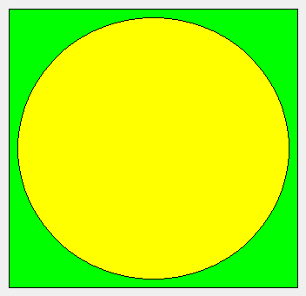
Basic Painting
This is a trivial paintEvent implementation
  Notice that the default pen is black
void RectWithCircle::paintEvent(QPaintEvent *ev)
{
QPainter p(this);
p.setBrush(Qt::green);
p.drawRect(10, 10, width()-20, height()-20);
p.setBrush(Qt::yellow);
p.drawEllipse(20, 20, width()-40, height()-40);
}
Notes:
Looking at painting from a practical point of view, this is an example of a paintEvent method.
First, the QPainter object is created, given this as the QPaintDevice to work with.
Then a brush is set, before a rectangle is drawn.
After the rectangle the brush is changed and an ellipse is drawn.
The default pen is black, that is why there is a black line around the circle and rectangle.
Continues

Slide 21
Convenient overloading
Most draw-functions have multiple ways to provide coordinates and settings
  drawRect(QRectF r);
  drawRect(QRect r);
  drawRect(int x, int y, int w, int h);
  drawPoint(QPointF p);
  drawPoint(QPoint p);
  drawPoint(int x, int y);
Notes:
In the previous slide we specified the rectangle to draw in as separate arguments – x, y, width, height.
Most drawing methods come in several overloaded flavors accepting QRect, QRectF, QPoint, QPointF, individual arguments, etc

Slide 22



Basic Shapes
QPainter::drawPoint
QPainter::drawLine
QPainter::drawRect
QPainter::drawRoundedRect
Notes:
The QPainter class provides numerous drawing methods. Knowing the available basic shapes helps when implementing painting algorithms.
drawPoint – draws a single dot
drawLine – draws lines
drawRect – draws rectangles
drawRoundedRect – draws rectangles with rounded corners
Continues

Slide 23



Basic Shapes
QPainter::drawEllipse
QPainter::drawArc
QPainter::drawPie
The arc and pie angles are specified
as 16ths of degrees, zero degrees
at three o'clock growing clock-wise
4320
2880
0 / 5760
1440
Notes:
The method drawEllipse draws ellipses (and circles)
Using the drawArc and drawPie methods, you can draw parts of an ellipse.
The arc and pie angles are given in 16ths of degrees. The zeroth angle starts to the right and grows in the clockwise direction.
Continues

Slide 24

Painting Text
QPainter::drawText
QPainter p(this);
QFont font("Helvetica");
p.setFont(font);
p.drawText(20, 20, 120, 20, 0, "Hello World!");
font.setPixelSize(10);
p.setFont(font);
p.drawText(20, 40, 120, 20, 0, "Hello World!");
font.setPixelSize(20);
p.setFont(font);
p.drawText(20, 60, 120, 20, 0, "Hello World!");
QRect r;
p.setPen(Qt::red);
p.drawText(20, 80, 120, 20, 0, "Hello World!", &r);
The rectangle r
represents the
extent of the text
Notes:
Painting text is done using the drawText methods.
The font used is represented by a QFont object and the text is painted in the pen color.
In the example, from the top down, we see how the font is created and assigned to the painter. It also possible to set the point size, taking the screen resolution into a account.
Then the first text is painted.
The next round, the pixel size, i.e. the maximum height in pixels, is set to ten pixels before the text is drawn again.
Then the pixel size is set to 20 and the text is painted again.
Finally, the pen color is changed and an (optional) QRect pointer is passed to the drawText method. This rect will contain the bounding rect of the text when it has been drawn.

Slide 25
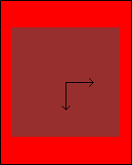
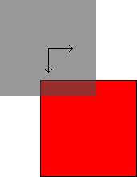
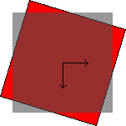
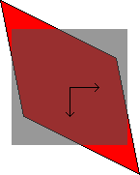
Transformations
QPainter::scale
QPainter::rotate
QPainter::translate
QPainter::shear
Notes:
The QPainter applies transformations to all graphics that it paints.
It is possible to apply scaling factors for each axis.
Translation, that is simply moving the origin of the axes, can be applied.
It is possible to rotate the entire coordinate system.
It is also possible to shear it.
(in the pictures, the gray box represents the untransformed box and the red one is the result after the transformation)
Continues

Slide 26
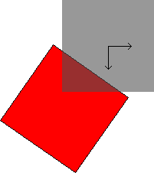
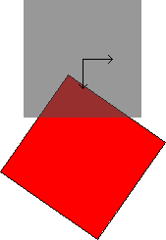
Transformations
Order of transformations is important
Origin is important when scaling, rotating and shearing
p.translate(0, 100);
p.rotate(35);
p.drawRect(-60, -60, 120, 120);
p.rotate(35);
p.translate(0, 100);
p.drawRect(-60, -60, 120, 120);
Notes:
When applying multiple transformations, it is important to keep in mind that the order of the translations is important.
For instance (left illustration), when first translating and then rotating an element, the shape is rotated around the translated origin
If the rotation is applied first (right illustration) and the item then is translated, the shape is rotated around the untranslated origin
By translating, then rotating and finally inverting the translation, it is possible to rotate a shape around an arbitrary origin
Continues

Slide 27

Transformations
Using save and restore, transformation states can be kept on a stack
Example, rotating around an arbitrary point
QPoint rotCenter(50, 50);
qreal angle = 42;
p.save();
p.translate(rotCenter);
p.rotate(angle);
p.translate(-rotCenter);
p.setBrush(Qt::red);
p.setPen(Qt::black);
p.drawRect(25,25, 50, 50);
p.restore();
p.setPen(Qt::NoPen);
p.setBrush(QColor(80, 80, 80, 150));
p.drawRect(25,25, 50, 50);
Apply transformations
Red rectangle
Gray rectangle
Notes:
Using the save and restore functions, it is possible to save and restore painter state, including transformations, from a stack.
In the example, the untranslated painter is saved, the translated and rotated (around the rotCenter point) rectangle is painted before the original painter is restored.
Continues

Slide 28
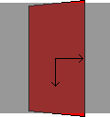
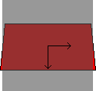
2.5D Transformations
When rotating, it is possible to rotate about any axis, creating a 3D effect
QTransform t;
t.rotate(60, Qt::YAxis);
painter.setTransform(t, true);
Notes:
Usually, you apply translations directly to the QPainter object using the scale, rotate, translate and shear methods.
Internally, the actually transforming is handled by a QTransform object. By explicitly creating such an object you get access to 2.5D (“two-and-a-half-dee”) transformations.
This means that you can rotate the coordinate system around the X or Y axis (instead of the Z axis that is oriented perpendicular to the screen surface).

Slide 29

A Gauge
An example of a custom widget: CircularGauge
Works as the CombinedGauge, but is a truly custom widget
  Same API as
  CombinedGauge, the
  value property
  Custom painting
  Can interact with
    keyboard
    mouse
Notes:
Returning to custom widgets, let's have a look at CircularGauge.
It behaves like the CombinedGauge, API wise.
It implements custom painting and event handing.
Continues

Slide 30

A Gauge
Painting the gauge background
void CircularGauge::paintEvent(QPaintEvent *ev)
{
QPainter p(this);
int extent;
if (width()>height())
extent = height()-20;
else
extent = width()-20;
p.translate((width()-extent)/2, (height()-extent)/2);
p.setPen(Qt::white);
p.setBrush(Qt::black);
p.drawEllipse(0, 0, extent, extent);
...
Centering the
gauge in the
available area
Drawing the
background circle
Notes:
The paintEvent consist of three steps. The first step is to draw the gauge background.
It is centered in the given area and kept circular.
The smaller of the width and height limits the extent of the background.
Continues

Slide 31
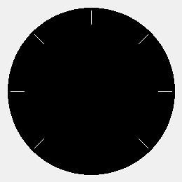
A Gauge
Painting the scale around the edge of the gauge
void CircularGauge::paintEvent(QPaintEvent *ev)
{
...
p.translate(extent/2, extent/2);
for(int angle=0; angle<=270; angle+=45)
{
p.save();
p.rotate(angle+135);
p.drawLine(extent*0.4, 0, extent*0.48, 0);
p.restore();
}
...
Notice the save and restore
pair inside the loop.
Simply calling rotate(45) accumulates
a potential rounding error.
Notes:
The next step is to draw the scale around the edge of the clock. This is achieved by rotating the entire coordinate system around the center point of the gauge.
The translate call handles the centering, while the save/rotate/restore calls handles the rotating.
You are discouraged from rotating an already rotated coordinate system, as repeated application of transformation can accumulate errors in the translation matrix.
Notice that the line that is drawn is always the same.
Continues

Slide 32

A Gauge
Painting the needle
void CircularGauge::paintEvent(QPaintEvent *ev)
{
...
p.rotate(m_value+135);
QPolygon polygon;
polygon << QPoint(-extent*0.05, extent*0.05)
<< QPoint(-extent*0.05, -extent*0.05)
<< QPoint(extent*0.46, 0);
p.setPen(Qt::NoPen);
p.setBrush(QColor(255,0,0,120));
p.drawPolygon(polygon);
}
The arrow is, untransformed,
pointing left and positioned
around the origin
Notes:
Finally, the arrow is painted. It is rotated according to the current value of the gauge.
The arrow itself is a QPolygon that is drawn using the drawPolygon method.
Continues

Slide 33
Acting on Events
There are more events than the paint event
  Keyboard events
  Mouse events
  window events, touch events, gesture events, timer events, change events, accessibility events, clipboard events, layout events, drag events, etc.
Notes:
When the paintEvent is implemented, the next step is to add handling of keyboard and mouse events.
There are many more events that can be handled:
window events, touch events, gestures events, timer events, change events, accessibility events, clipboard events, layout events, drag events, and more
The default event handling methods usually provide a neutral, sane default. It is only necessary to re-implement the event handles that you actually need.
Continues

Slide 34
Reacting to Keys
Re-implement the protected keyPressEvent
Act on the key being pressed
Pass non-used keys to the base class
void CircularGauge::keyPressEvent(QKeyEvent *ev)
{
switch(ev->key())
{
case Qt::Key_Up:
case Qt::Key_Right:
setValue(value()+1);
break;
case Qt::Key_Down:
case Qt::Key_Left:
setValue(value()-1);
break;
case Qt::Key_PageUp:
setValue(value()+10);
break;
case Qt::Key_PageDown:
setValue(value()-10);
break;
default:
QWidget::keyPressEvent(ev);
}
}
Notes:
Keyboard interaction can be intercepted through the keyPressEvent and keyReleaseEvent.
In this case, we are satisfied with overriding the keyPressEvent method.
For each key that we are interested in (up, down, left, right, page up and page down) we take action. For all other keys we propagate the event to the base class (QWidget) keyPressEvent method.
Continues

Slide 35
Reacting to the Mouse
Mouse events are handled through overriding the following protected methods
  mousePressEvent and mouseReleaseEvent
  mouseMoveEvent – only called while a button is
  pressed unless mouseTracking is enabled
setValueFromPos is
a private method
for converting a
point into an angle
void CircularGauge::mousePressEvent(QMouseEvent *ev)
{
setValueFromPos(ev->pos());
}
void CircularGauge::mouseReleaseEvent(QMouseEvent *ev)
{
setValueFromPos(ev->pos());
}
void CircularGauge::mouseMoveEvent(QMouseEvent *ev)
{
setValueFromPos(ev->pos());
}
Notes:
The mouse events are handled through the mousePressEvent, mouseReleaseEvent and mouseMoveEvent event handlers.
The mouse move event is only triggered when a mouse button is pressed, so we do not have to keep track of that. (it is possible to get all mouse movements by enabling the mouseTracking property)
The QMouseEvent structure contains a position, indicating the location of the pointer. For this widget, we simply pass this on to the setValueFromPos function that handles the conversion.

Slide 36
Drawing less is quicker
The paintEvent method takes a QPaintEvent as argument
The QPaintEvent has two methods
  QRect rect – returns the rectangle needing repainting
  QRegion region – returns the region needing repainting
A region is more complex than a rectangle
When re-painting, try to avoid drawing complex shapes outside the rectangle / region
Notes:
Drawing complex widgets can be a time consuming process.
Keeping an optimized paintEvent method is key to improving performance.
With each paintEvent call, a QPaintEvent object is given as argument.
The QPaintEvent object contains a rectangle and a region (i.e. a complex area) to paint.
When painting complex parts of the design, for instance text, try to take the rectangle into account.

Slide 37
QTimer
QTimer is used to let the clock generate events
Or to delay an action
  passes through the event loop, can be used to queue slot calls
MyClass(QObject *parent) : QObject(parent)
{
QTimer *timer = new QTimer(this);
timer->setInterval(5000);
connect(timer, SIGNAL(timeout()), this, SLOT(doSomething());
timer->start();
}
Every 5000ms
i.e. every 5s
QTimer::singleShot(1500, dest, SLOT(doSomething());
Notes:
An event source that can be very handy, but isn't related to user interaction, is the QTimer.
The QTimer object can be used to emit a signal at even intervals.
In the example, a QTimer is setup to to emit the timeout signal every 5 seconds. This is connected to a slot and then the timer is started.
It is also possible to use the QTimer to request single calls to a given slot.
As QTimer relies on timer events, the single-shot signals with zero delay can be used to post requests on the event queue. For instance, calling functions from slots where the slot must return quickly.

Slide 38
The Event Mechanism
All events are posted on the Qt event queue
In the event queue, they can be processed
  Only the last mouseMoveEvent will be delivered
  Multiple paintEvent requests can be merged
When a QObject receives an event, the event method is activated
  The event method can either accept or ignore the event
  Ignored events are propagated through the object hierarchy
Notes:
As mentioned earlier, events are handled by the event loop. The event loop feeds of the event queue.
All Qt events are posted to the event queue. The queue can prioritize and process events.
Examples of this is that mouseMoveEvents aren't stored – you only get the latest. paintEvents are merged if possible, to reduce the number of repaints.
On a low level, events are delivered to the QObject::event method. This method accepts or ignores events.
When events are ignored they are propagated through the object hierarchy depending on the nature of the event.
The QWidget class has reimplemented the event method, distributing the events to protected virtual methods such as paintEvent, keyPressEvent, etc.

Slide 39
Filtering Events
It is possible to install event filters on a QObject
The filter itself is a QObject that implements the eventFilter method
An event filter receives the watched object's events and can let them through or stop them
  Can be used to add functionality to an object without sub-classing
  Can be used to prevent a given event from reaching its target
Notes:
It is possible to install an event filter on a QObject. This allows you to filter events before they reach the object in question.
An event filter object is a QObject that re-implements the eventFilter method. That object is then installed on another QObject.
Filtering events can be useful for removing events from a given object or to add functionality to a given object without having to subclass it.
Continues

Slide 40
Filtering Events
Implementing a filter for the gauges
  Adds a function: Pressing 0 (zero) zeroes the value
class KeyboardFilter : public QObject ...
bool KeyboardFilter::eventFilter(QObject *o, QEvent *ev)
{
if (ev->type() == QEvent::KeyPress)
if (QKeyEvent *ke = static_cast<QKeyEvent*>(ev))
if (ke->key() == Qt::Key_0)
if (o->metaObject()->indexOfProperty("value") != -1 )
{
o->setProperty("value", 0);
return true;
}
return false;
}
true uses the event,
i.e. it is not passed on
to the watched object
Notes:
For example, we can implement an event filter designed to be used with the CircularGauge or ComposedGauge widgets.
The class is called KeyboardFilter and inherits QObject.
In the event filter method, they event type is used to determine if it is a KeyPress event.
If so, we check if the key “0” (zero) was pressed.
If that is the case, we set the property “value” of the observed object to zero (if there is a property called “value”).
Continues

Slide 41
Installing the filter
Activating the filter is as easy as calling installEventFilter
As the filter works on the property, not a particular class, it can be used with QSlider, QDial, QSpinBox, etc.
The brave can install an event filter on the QApplication
ComposedGauge compg;
CircularGauge circg;
KeyboardFilter filter;
compg.installEventFilter(&filter);
circg.installEventFilter(&filter);
Notes:
Installing the event filter on the widgets is then a question of calling installEventFilter.
The filter can be used with a variety of widgets. E.g. sliders, dials, spinboxes.
For the brave, it is possible to install event filters on the QApplication object itself. This intercepts all events to the entire application.

Slide 42
Break

Slide 43
Style Aware Widgets
Qt paints widgets using different styles on different platforms
  Control the style used from the command line
For widgets to properly integrate across platforms they must be made style aware
  Build from standard elements
  Use platform specific elements when painting
  Asking the platform style for sizes
./myapplication -style name-of-style
Notes:
When painting custom widgets, you must take cross platform issues into account.
For instance, frames, icons, sizes and such differ between platforms.
To make a custom widget work across multiple platforms, these differences must be taken into account.
Continues

Slide 44
Avoiding Style Awareness
Style awareness means that you have to make your widget fit in across all platforms
Consider using existing widgets
  Directly or in composed widgets
Use QFrame as base
  If the content is independent of style
Notes:
There are methods to avoid having to adapt to all platforms.
The easiest way is to stick to existing widgets – either partly or completely.
For instance, composing a custom work area with QPushButton widgets ensures that the buttons always look right.
For widgets with frames, the QFrame is a good base class (instead of QWidget).
Continues

Slide 45







The Structure of Styles
Complex controls
  Sub-controls
Primitive elements
Control elements
Metrics
Standard pixmaps
Notes:
If you decide to take on style awareness, the best approach is to rely on the QStyle set of classes.
They handle styles in a number of ways:
Complex controls are built from sub-controls – example QSpinBox
Sub-control elements – example spinbox up, spinbox down, spinbox frame
Primitive elements – example various frames, symbols (arrows, plus, minus)
Control elements – push button (built from the control elements push button bevel, push button label and focus rectangle)
Metrics – calculate which rect to use for sub-controls and which areas that are active – example check boxes only have a small clickable area
Standard pixmaps – example various icons
Continues

Slide 46
Style Options
When painting elements using QStyle, a QStyleOption instance is used to convey information such as
  Font
  Palette
  Rectangle on screen
  State (active, has focus, is selected, etc)
  Element specific settings (e.g. icon and text)
Notes:
When using the QStyle classes for painting, the QStyleOption structure is used to convey the settings for the element in question.
The structure contains items such as:
the palette to use
the font
the rectangle to operate on
the state of the widgets
etc
There is a whole inheritance tree of QStyleOption classes targetting different sub-elements and widgets
Continues

Slide 47
Painting using styles
void Widget::paintEvent(QPaintEvent *event)
{
QPainter painter(this);
QStyleOptionFocusRect option;
option.initFrom(this);
option.backgroundColor = palette().color(QPalette::Background);
style()->drawPrimitive(QStyle::PE_FrameFocusRect,
&option, &painter, this);
}
Notes:
Looking at a concrete example, the code above draws a focus rectangle in a cross platform way.
The paintEvent start by creating a QPainter
Then a QStyleOption for focus rectangles, QStyleOptionFocusRect is instantiatied.
Finally, the style of the widget is asked to draw the primitive PE_FrameFocusRect (PE = Primitive Element) with the options, the painter on this widget.
Continues

Slide 48
QStylePainter
The QStylePainter class encapsulates the QPainter and QStyle
void MyWidget::paintEvent(QPaintEvent *event)
{
QStylePainter painter(this);
QStyleOptionFocusRect option;
option.initFrom(this);
option.backgroundColor = palette().color(QPalette::Background);
painter.drawPrimitive(QStyle::PE_FrameFocusRect, option);
}
Notes:
If your widget only relies on styles for painting, i.e. is built only from standard primitives, you can use a QStylePainter instead of a QPainter.
This removes the need to explicitly refer to the style and painter, but otherwise does exactly the same job.

Slide 49
Widgets in Designer
Having created custom widgets, you can include them in Designer
  Write a plugin based on implementing QDesignerCustomWidgetInterface
  Read more at
  http://doc.trolltech.com/designer-creating-custom-widgets.html
  and
  http://doc.trolltech.com/4.6/designer-customwidgetplugin.html
Notes:
Having created custom widgets, it is good to know that you can add them to the Designer environment by implementing a plugin.
That is outside the scope for this lecture, but for the interested students, there are a couple of links that are good starting points.

Slide 50
Classes around Painter
When using QPainter, you encounter a number of surrounding classes
  QColor – represents a color, including transparency
  QPen – represents a pen used for stroking outlines
  QBrush – represents a brush for filling interiors
Notes:
The QPainter class does not handle all painting by itself. Instead, it relies on a whole range of classes that provide detailed control of most aspects associated with painting.
The most common ones are:
QColor – represents colors and transparency
QPen – represents a pen, for stroking outlines
QBrush – represents the brush, for filling interiors
Continues

Slide 51
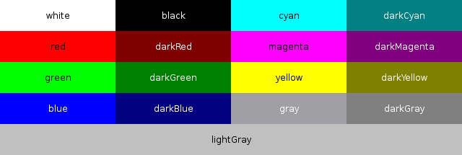
QColor
The constructor of QColor takes three colors and an alpha channel
  The alpha channel controls how transparent or opaque the color is
Qt provides a range of predefined colors
QColor( int r, int g, int b, int a )
Notes:
QColor class can be used to compose any rgb color with any transparency.
There are also a range of Qt defines for commonly used colors.
Continues

Slide 52
Color Spaces
The RGB colorspace is commonly used for computers, but there are more colorspaces
  CMYK – commonly used in printing
  HSV / HSL – used in color pickers, etc
QColor can be set from any of these colorspaces using static functions
  QColor::fromCmyk
  QColor::fromHsl
  QColor::fromHsv
Notes:
The RGB color space is the most commonly used color space for on-screen graphics. Most of today's monitors are built around red, green and blue dots, so it is natural to have the same representation in QColor.
There are other color spaces that are quite common too.
The CMYK color space is popular in the printing industry (Cyan, Magenta, Yellow and blacK).
The HSV/HSL color spaces is what we see in color pickers, but also in other places. Hue, Saturation and Value/Lightness.
Continues

Slide 53
Color Spaces cont'd
The values of the individual components of RGB, CMYK, HSL and HSV colors can be read using
  getRgb, getCmyk, getHsl, getHsv
The can also be read individually using
  red, green, blue, cyan and magenta, yellow, black
  hslHue, hslSaturation, lightness
  hsvHue, hsvSaturation, value
  alpha
getRgb(int *r, int *g, int *b)
Notes:
The individual components of each color space can be read using the getRgb, getCmyk, getHsl and getHsv methods.
Each individual component can also be read using specific methods.
Worth noticing is that the QColor class can be used to convert colors between color spaces. It is fully valid to set the color using CMYK and then read out the RGB components. This can, however, introduce rounding errors.
Continues

Slide 54

Tuning Colors
The QColor class lets you create lighter and darker colors
  QColor::lighter( int factor )
  QColor::darker( int factor )
darker
Qt::red
lighter
Notes:
When you have defined a QColor for a color that you need, you can use the lighter and darker functions to tune that color. For instance, to create shadow effects.
Continues

Slide 55
QRgb
The QColor class is great for representing colors, but when storing colors, a more compact alternative is needed
QRgb is a 32-bit color triplet with alpha (RGB+A)
Notes:
The QColor class is great for representing and working with color.
A more basic, direct, way of storing color is to use the QRgb color type. It stores 8 bits per channel for red, green, blue and alpha.
Continues

Slide 56
QRgb
Create new QRgb values using qRgb and qRgba
Read components using qRed, qGreen, qBlue, qAlpha
Convert to gray scale using qGray
  Not the average value – weighted by luminance
QRgb orange = qRgb(255, 127, 0);
QRgb overlay = qRgb(255, 0, 0, 100);
int red = qRed(orange);
int gray = qGray(orange);
Notes:
As QRgb is a type and not a class, you must use the qRgb and qRgba functions to create new values.
To extract components, use the qRed, qGreen, qBlue and qAlpha functions.
To get a (proper) gray color from any RGB color, use the qGray function. Useful when generating inactive images and such.

Slide 57
Pens
When stroking outlines of shapes, a QPen is used.
A pen defines properties such as color, width and line style
Pens can be cosmetic, i.e. not affected by transformations
  Set using setCosmetic(bool)
  Can greatly improve performance
Notes:
The QPen class represents a pen.
A pen has properties such as color, width and line style (i.e. dashed, solid, dotted, etc)
It is also possible to have cosmetic pens. They are not affected by transformations. This means that the width of the line is not scaled.
The shape being drawn using the pen is still transformed though.
Using cosmetic pens is something that really can improve performance if you use transformations.
Continues

Slide 58


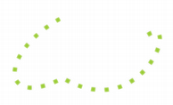

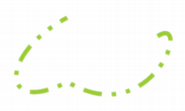
Line Styles
The line style is set using the setStyle method
  Qt::SolidLine
  Qt::DashLine
  Qt::DotLine
  Qt::DashDotLine
  Qt::DashDotDotLine
  Qt::CustomDashLine – controlled by dashPattern
Notes:
The line style is set using the QPen::setStyle method
The available options are: solid, dashed, dotted, dask-dotted, dash-dot-dotted and, or course, custom.
Continues

Slide 59
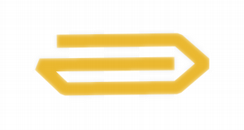



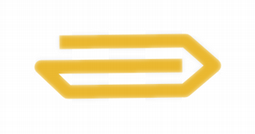

Joining and Ending Lines
joinStyle
  Qt::BevelJoin (default)
  Qt::MiterJoin
  Qt::RoundJoin
capStyle
  Qt::SquareCap (default)
  Qt::FlatCap
  Qt::RoundCap
Square covers
the end point
flat does not
cover the end
Notes:
The joinStyle and capStyle properties control how lines are joined respectively how line ends are capped.
The join styles can be bevel, miter or round, where bevel is the default style.
The line ends can be square, flat or round, where square is the default.
The difference between square and flat is that square line ends overshoot the endpoint by half the line width, while flat ends do not.

Slide 60
Brushes
Brushes are used for filling the interior of shapes
There are several types of brushes, all available through the QBrush class
They can be divided into the following groups
  Solid
  Patterned
  Textured
  Gradients
Notes:
Brushed are used for filling the interior of shapes. This can be much more interesting than one might think.
The QBrush class represents all types of brushes. The available types can be divided into a set of groups:
solid, i.e. one solid color
patterned, a colored pattern
textured, using an image as a brush
gradients, there are several types of gradients, but filling with colors gradually changing over a scale of colors
Continues

Slide 61
Solid Brushes
Solid, single color, brushes are created by giving the QBrush constructor a color as argument
QBrush red(Qt::red);
QBrush odd(QColor(55, 128, 97));
Notes:
The most basic type brushes are solid brushes.
Simply pass a color to the QBrush constructor, and you have a solid brush of that given color.
Continues

Slide 62
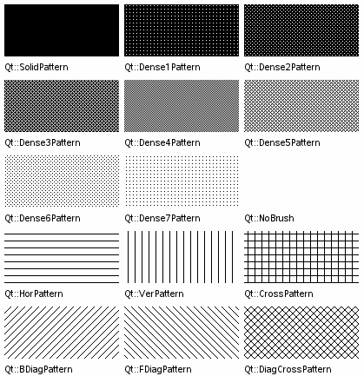
Patterned Brushes
A solid brush is really an instance of a patterned brush, but with a different brushStyle
QBrush( const QColor &color, Qt::BrushStyle style )
Notes:
A solid brush is really just a patterned brush, but with a solid pattern. There are a whole set of patterns, controlled by the brushStyle property.
You can pass a brush style to the QBrush constructor, thus creating a patterned brush.
Continues

Slide 63
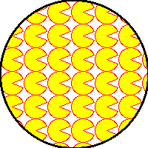
Textured Brushes
A textured brush uses a QPixmap as texture
QBrush( const QPixmap &pixmap )
QPixmap pacPixmap("pacman.png");
painter.setPen(QPen(Qt::black, 3));
painter.setBrush(pacPixmap);
painter.drawEllipse(rect());
If the texture is monochrome,
the color of the brush is used.
Otherwise the pixmap's colors are used.
Notes:
Textured brushes uses a pixmap as a brush. The pixmap is repeated to fill the surface.
If you use a monochrome pixmap, the brush can also be given a color. Otherwise the pixmap is used as it is.
Continues

Slide 64

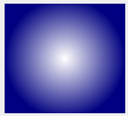
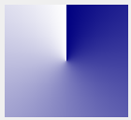
Gradients
QLinearGradient | QRadialGradient | QConicalGradient
Create a QBrush by passing a QGradient object to it, e.g.
QBrush b = QBrush( QRadialGradient( ... ) );
Notes:
The most complex type of brush is the gradient brush.
A gradient brush is created through passing a gradient object to the QBrush constructor.
There are three types of gradient objects – linear, radial and conical. They basically work the same way. The difference is how the colors are spread: between two points (linear), from a point (radial) or around a point (conical)
Continues

Slide 65



A Generic Gradient
Divides the distance from a start point to a end point in the 0.0 to 1.0 range
Spread the colors outside the interval
QGradient::setColorAt( qreal pos, QColor );
PadSpread (default) | RepeatSpread | ReflectSpread
Notes:
Gradients always spread the colors in the range zero to one.
Using the setColorAt method, you set colors for each value, producing a set of colors to gradually move between.
Outside the zero-to-one-interval, the colors can be spread in different ways. The default behavior is to simply continue with the last color. It is also possible to either repeat, or reflect the spectrum.
Continues

Slide 66

Example: a linear gradient
setColorAt(0.7,
QColor(255, 0, 0))
setColorAt(0.0,
QColor(0, 0, 0))
setColorAt(1.0,
QColor(255, 255, 0))
Notes:
The picture here shows a linear gradient moving between black and yellow, but passing over red after 70% of the distance.

Slide 67
Using pens and brushes
To avoid filling or stroking, clear the pen or brush
It can be costly to change pen and brush
  Plan you painting to gain performance.
QPainter p;
p.setPen(Qt::NoPen);
p.setBrush(Qt::NoBrush);
Notes:
Pens and brushes must be have a QPainter to be useful.
Simply use the setPen and setBrush functions to set new pens and brushes.
To clear a painter from a pen, you can use the Qt::NoPen as pen.
The same goes for brushes, use Qt::NoBrush.
Remember that changing pens and brushes can be costly. To improve painting performance you are recommended to plan your painting in such a way that you minimize the number of changes.

Slide 68
Text
Painting text can be a complex task
  Font sizes
  Alignment
  Tabs
  Wrapping
  Flowing around images
  Left-to-right and right-to-left
Notes:
Painting text is one of the trickier aspects. Especially when trying to fit text into constraints set by other graphics.
Aspects to take into account are:
font size (and font availability in a cross platform setting)
alignment
tabs
word wrapping
trying to flow the text around or inside other shapes
the direction of writing
Continues

Slide 69
QPainter and Text
Basic painting of text
Painting of text with options
Painting of text with feedback
drawText( QPoint, QString )
drawText( QRect, QString, QTextOptions )
drawText( QRect, flags, QString, QRect* )
Notes:
It can be easy to draw text.
The QPainter class offers methods with different degrees of control.
You can call drawText with a point and a string. This just draws the text, starting from the given point.
You can also draw the text in a rectangle with some options (i.e. what to do when you run out of space, etc)
Finally, you can draw the text in a rectangle and find out how much space actually was used.
Continues

Slide 70
Fonts
The QFont class represents a font
  Font family
  Size
  Bold / Italic / Underline / Strikeout / etc
Notes:
Fonts are represented by QFont objects. Each such object holds settings such as:
font family
size (in pixels or points)
iwhether the font is bold, italic, etc
Continues

Slide 71
Font Family
Create new QFont instances by specifying the font name to the c'tor
Use QFontDatabase::families to get a list of available fonts.
QFont font("Helvetica");
font.setFamily("Times");
QFontDatabase database;
QStringList families = database.families();
Notes:
The easiest way to create a QFont object is to pass a family name to the constructor.
If you want to ensure the availability of a font, the QFontDatabase class can provide information.
Continues

Slide 72
Font Size
Fonts can either be sized using pixel size or point size
Notice that the pixelSize == -1 if the size was set using setPointSize and vise versa
QFont font("Helvetica");
font.setPointSize(14); // 12 points high
// depending on the paint device's dpi
font.setPixelSize(10); // 10 pixels high
Notes:
Fonts are usually measured in points. This takes the resolution of the screen into account and is intended to produce the same size of text for different screens and different machines. Use the setPointSize to alter the font size in this way.
Sometimes, that is not the goal. Then you can use the setPixelSize method to set the font's size in actual screen pixels.
Notice that the QFont object cannot be used as a mechanism for converting from pixels to points and vise versa.
Continues

Slide 73
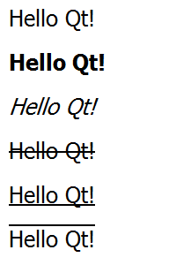
Font Effects
Font effects can be enabled or disabled
QWidget::font and QPainter::font returns a const QFont reference, i.e. you must modify a copy
Normal, bold,
italic, strike out,
underline,
overline
QFont tempFont = w->font();
tempFont.setBold( true );
w->setFont( tempFont );
Notes:
Each font can have a number of effects, or combinations of effects, assigned to it
Normal
Bold
Italic
Strike out
Underline
Overline
When modifying fonts, it is good to know that QWidget::font and QPainter::font returns a const QFont reference. This means that you must copy that font before modifying it and then setting it again.
Continues

Slide 74
Measuring Text
It is interesting to know how large a text will be before painting it
  QFontMetrics is used to measure text and fonts
  The boundingRect function makes it easy to measure the size of a text block
QImage image(200, 200, QImage::Format_ARGB32);
QPainter painter(&image);
QFontMetrics fm(painter.font(), &image);
qDebug("width: %d", fm.width("Hello Qt!"));
qDebug("height: %d", fm.boundingRect(0, 0, 200, 0,
Qt::AlignLeft | Qt::TextWordWrap, loremIpsum).height());
Notes:
One of the challenges when drawing text is to be able to fit the text into the rest of the graphics, or vise versa. That is, to fit the graphics around the text.
To be able to do this, you will have to measure the text. For that task, you can use the QFontMetrics class. It takes a font, and optionally a context.
Using it you can measure widths, heights, bounding rectangles, etc
Continues

Slide 75
Measuring Text
These measurements are useful when aligning text with other graphics
Gg
ascent
height
= ascent + descent + 1
descent
Notes:
When measuring fonts, it is good to know the concepts of ascent, descent and height
The line between the ascent and descent is known as the base line.
Continues

Slide 76
Working with Documents
The QTextDocument class is used to handle rich text documents
  Consists of blocks of text, QTextBlock
  Lays out the text using a QAbstractTextDocumentLayout layout engine
  Using the standard layout engine, it is possible to render rich text to any QPainter
Notes:
For more complex pieces of text, the QTextDocument class can be used.
These texts can have different fonts, effects, colors and more assigned to it. They contain rich text.
Each text document contains a set of text blocks
The text document then lays out the block using a text document layout engine
The standard layout engine makes it possible to render rich text to any QPainter, but by creating a custom layout engine, it is possible to create more advanced rules for text flow, etc
Continues

Slide 77
The Document Classes
QTextDocument
QTextBlock
QAbstractTextDocumentLayout
QTextLayout
Updates the layouts upon
document changes
Used for traversing
and modifying
documents
QTextCursor
Notes:
The relationship between the classes involved when working with QTextDocument are shown below
Each text document contains a range of QTextBlock objects. Each of these are then laid out in QTextLayout objects.
The document also contains a layout engine, in this example the QAbstractTextDocumentLayout, which updates the QTextLayout as the document changes
Finally, there is the QTextCursor class used for traversing text documents and performing manipulations
Continues

Slide 78
Painting with Text Documents
Use the textWidth property to control the width
  Read the resulting height using size
Use the pageSize property to control pagination
  pageCount holds the resulting number of pages
Notes:
When you want to use a QTextDocument for painting, the textWidth property controls the width of the text. The result from this is the size property, containing the height of the text laid out with the width limitation
The pageSize property controls the size of each page of text. The pageCount property then holds the resulting number of pages
Continues

Slide 79
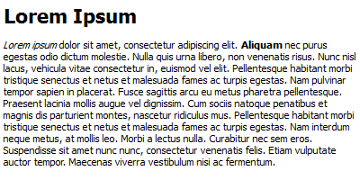
Working with Text Documents
Use drawContents to draw the contents of a document using a QPainter
Use setTextWidth to limit the width of the text
QPainter painter;
QTextDocument doc;
doc.setTextWidth(width());
doc.drawContents(&p, rect());
Notes:
All the details surrounding QTextDocument may sound very intimidating, but painting a rich text document is really quite easy.
First, you need a QPainter and a QTextDocument
Then, set the width of the text using the setTextWidth method
Finally, render the document onto the painter using the drawContents method

Slide 80
Images
QPixmap
Optimized for showing images on-screen
QImage
Optimized for manipulation
If you plan on painting a QImage to the screen even twice, it is better to convert it to a QPixmap first
Notes:
Sometimes, you do not wish to draw onto the screen. Instead an off-screen surface is what you want.
Qt provides two such surfaces: QPixmap and QImage
The difference between the two is that QPixmap is optimized for being drawn onto the screen, e.g. for holding a cache or an image that is a part of the user interface
The QImage is optimized for manipulation, that is for being painted to
So, if you draw your graphics to a QImage, as it is optimized for manipulation – when do you convert it to a QPixmap? The answer is that if you plan to copy it to the screen more than once, the conversion is worthwhile. That is how expensive the conversion is.
Continues

Slide 81
Converting
Conversion between the QImage and QPixmap is handed in QPixmap
QImage QPixmap::toImage();
QPixmap QPixmap::fromImage( const QImage& );
Notes:
As the two classes basically represents the same thing, it is very easy (although potentially expensive) to convert between the two.
The QPixmap class contains the toImage method and the static fromImage method for this.
Continues

Slide 82
Loading and Saving
QPixmap pixmap( "image.png" );
pixmap.save( "image.jpeg" );
QImage image( "image.png" );
image.save( "image.jpeg" );
This code uses the QImageReader and
QImageWriter classes. These classes determine
the image file format from extension when saving.
Notes:
Both QImage and QPixmap drawings can easily be loaded from disk, as well as saved to disk.
All these operations rely on the QImageReader and QImageWriter classes. These in turn rely on a set of plugins for supporting different image formats.
It is possible to extend Qt with support for more format using plugins. You can also limit the number of formats supported when configuring Qt, if building it yourself.
Continues

Slide 83
Painting to a QImage
The QImage is a QPaintDevice, so a QPainter can paint on it
QImage image( 100, 100, QImage::Format_ARGB32 );
QPainter painter(&image);
painter.setBrush(Qt::red);
painter.fillRect( image.rect(), Qt::white );
painter.drawRect(
image.rect().adjusted( 20, 20, -20, -20 ) );
Notes:
In order to paint to a QImage, you simply setup a QPainter for it.
As the QImage class is a QPaintDevice, the QPainter works right away.
This applies to the QPixmap class as well.
Continues

Slide 84
Painting a QPixmap
QPixmap is optimized for being painted onto the screen
void MyWidget::imageChanged( const QImage &image )
{
pixmap = QPixmap::fromImage( image );
update();
}
void MyWidget::paintEvent( QPaintEvent* )
{
QPainter painter( this );
painter.drawPixmap( 10, 20, pixmap );
}
Notes:
The QPixmap class is optimized for being painted onto the screen. This means that it is the natural choice for keeping a cache copy of something that is expensive to draw.
This could be a complex graph, or just a QImage
In the example, the MyWidget class has a imageChanged method which is called to change an image. This assign the pixmap with the converted image and request an update.
In the following paintEvent, the pixmap is then drawn onto the widget, i.e. the screen.

Slide 85
Scalable Vector Graphics
The SVG file format is a W3C standard for describing vector graphics using XML
Qt supports both generating and reading SVG files
All SVG related classes reside in the QtSvg module
Notes:
The QImage and QPixmap classes both handle bitmapped, i.e. pixel-based, pictures
For scalable graphics, a vector based approach is required.
Qt provides good support for SVG, Scalable Vector Graphics. It is an XML-based format standardized by W3C.
Qt can both generate and render SVG contents
The SVG support is kept in the QtSvg module, so you need to include that module in your projects when working with vector graphics
Continues

Slide 86
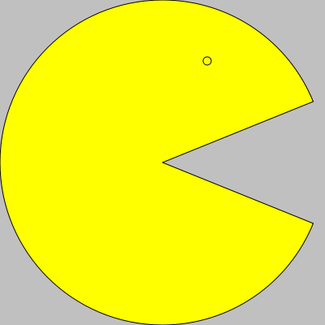
Rendering SVG
Using the QSvgRenderer and the load and render methods, it is possible to render an SVG file to a QPainter
Use the defaultSize and viewBox methods to determine the size of the rendered graphics
QPainter painter;
QSvgRenderer renderer;
renderer.load(QString("svg-test.svg"));
renderer.render(&painter);
Notes:
The QSvgRenderer class is used to render SVG through a QPainter.
As the painter can be used to draw to any type of QPaintDevice, this means that SVGs can be rendered onto QImage, QPixmap as well as directly onto widgets
The defaultSize and viewBox methods of the renderer can be used to determine the size of the rendered graphics
Continues

Slide 87
Generating SVG
To generate SVG files, use a QSvgGenerator as the QPaintDevice and open a QPainter to it
QSvgGenerator generator;
generator.setFileName("svg-test.svg");
generator.setSize(QSize(200, 200));
generator.setViewBox(QRect(0, 0, 200, 200));
QPainter p;
p.begin(&generator);
p.setPen(Qt::black);
p.setBrush(Qt::yellow);
p.drawPie(0, 0, 200, 200, 22*16, 316*16);
p.drawEllipse(125, 35, 5, 5);
p.end();
Notes:
Generating SVG files is almost as easy. The QtSvg module provides the QSvgGenerator class which acts as a QPaintDevice.
By painting to a QSvgGenerator, you generate SVG contents which is stored in a file.
The code in the example generates the pacman head from the previous slide.

